Slide 1



Ignatius Evans Erlangga
20th of June, 2024
https://github.com/evanserlangga/IBMDSPFP

Slide 2

Outline
Executive Summary
Introduction
Methodology
Results
Conclusion
Appendix

Slide 3
Executive Summary
I collected data from the public SpaceX API and SpaceX Wikipedia page. I created a 'class' column to classify successful landings. Using SQL, visualization techniques, folium maps, and dashboards, I explored the data. I selected relevant columns as features for analysis. Categorical variables were converted to binary using one-hot encoding. After standardizing the data, I employed GridSearchCV to optimize parameters for machine learning models. Finally, I visualized the accuracy scores of all models.
Four machine learning models were generated: Logistic Regression, Support Vector Machine, Decision Tree Classifier, and K Nearest Neighbors. Each achieved an accuracy rate of approximately 83.33%. Interestingly, all models tended to over-predict successful landings. To improve model accuracy and reliability, additional data is necessary for better determination.

Slide 4
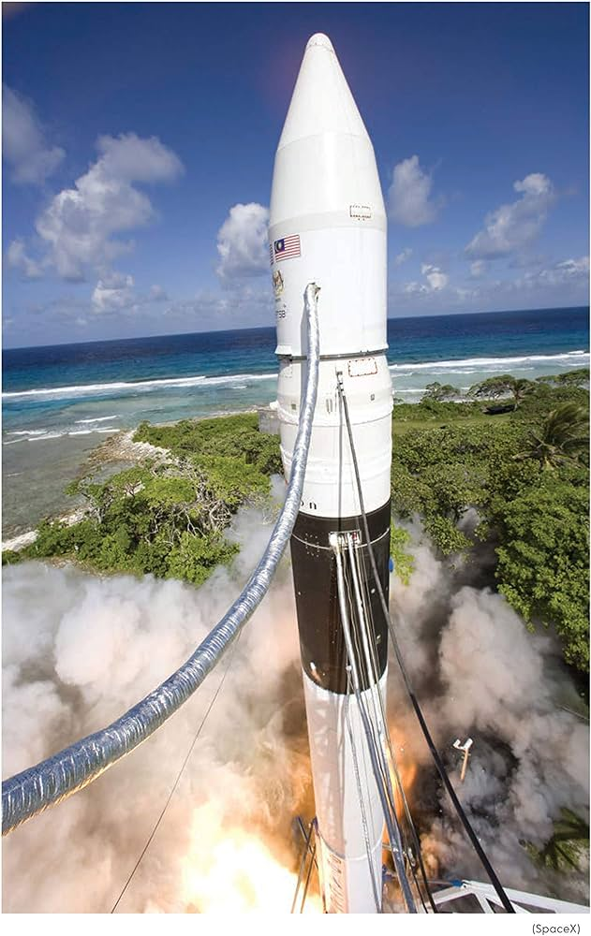
Introduction
Background :
The commercial space age is now a reality. SpaceX leads with competitive pricing at $62 million compared to $165 million USD for its rivals. This cost advantage is largely attributed to SpaceX's capability to recover and reuse the first stage of its rockets. Space Y is aiming to rival SpaceX in this competitive market.
Task :
Space Y has assigned us the responsibility of developing a machine learning model aimed at forecasting the successful recovery of Stage 1 rockets. This initiative aligns with their goal to enhance operational efficiency and reliability in their space missions, aiming to compete effectively in the commercial space industry, which is increasingly driven by the ability to recover and reuse rocket components.

Slide 5

Section 1

Slide 6
Methodology
Executive Summary
Data collection methodology:
The data collection methodology involved combining data from the SpaceX public API and the SpaceX Wikipedia page.
Perform data wrangling
Data Wrangling was perform to clean and prepare the data, afterwards Successful and Unsuccessful Landings were classified based on specific criteria.
Perform exploratory data analysis (EDA) using visualization and SQL
EDA was conducted using SQL and various visualization techniques to gain insights.
Perform interactive visual analytics using Folium and Plotly Dash
Interactive visual analytics were implemented.
Perform predictive analysis using classification models
Predictive analysis was carried out using classification models, and model parameters were fine-tuned using GridSearchCV.

Slide 7
Data Collection
The data collection process included utilizing API requests from SpaceX's public API and scraping data from a table found in SpaceX's Wikipedia entry. The subsequent slide will illustrate the flowchart depicting the data collection process from the API, followed by another slide detailing the flowchart for data collection through web scraping.
Space X API Data Columns:
FlightNumber, Date, BoosterVersion, PayloadMass, Orbit, LaunchSite, Outcome, Flights, GridFins, Reused, Legs, LandingPad, Block, ReusedCount, Serial, Longitude, Latitude
Wikipedia Webscrape Data Columns:
Flight No., Launch site, Payload, PayloadMass, Orbit, Customer, Launch outcome, Version Booster, Booster landing, Date, Time

Slide 8
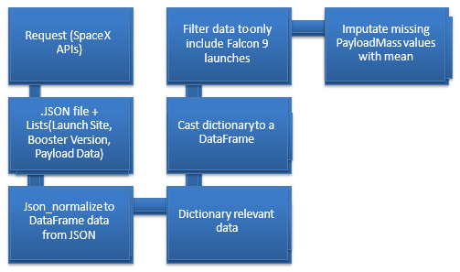
Data Collection – SpaceX API
GitHub URL :
https://github.com/evanserlangga/IBMDSPFP/blob/ae5350a75d04afc0344e178494715908fb1de441/jupyter-labs-spacex-data-collection-api.ipynb

Slide 9
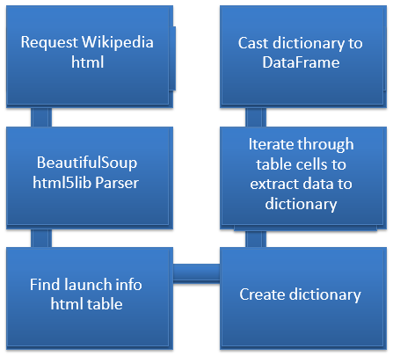
Data Collection - Scraping
GitHub URL :
https://github.com/evanserlangga/IBMDSPFP/blob/ae5350a75d04afc0344e178494715908fb1de441/jupyter-labs-webscraping.ipynb

Slide 10
Data Wrangling
To create a training label with landing outcomes where successful landings are represented as 1 and failures as 0, follow these steps:
The 'Outcome' column consists of two components: 'Mission Outcome' and 'Landing Location'.
Create a new column called 'class' for the training label. This column will have a value of 1 if the 'Mission Outcome' is True, and 0 otherwise. The value mapping is as follows:
True ASDS, True RTLS, and True Ocean are mapped to 1.
None None, False ASDS, None ASDS, False Ocean, and False RTLS are mapped to 0.
This approach ensures that successful landings are correctly labeled for training the machine learning model.
GitHub URL :
https://github.com/evanserlangga/IBMDSPFP/blob/ae5350a75d04afc0344e178494715908fb1de441/labs_jupyter_spacex_Data_wrangling.ipynb

Slide 11
EDA with Data Visualization
Exploratory Data Analysis (EDA) was conducted on several variables, including Flight Number, Payload Mass, Launch Site, Orbit, Class, and Year. The analysis involved creating various plots to examine the relationships between these variables:
Flight Number vs. Payload Mass
Flight Number vs. Launch Site
Payload Mass vs. Launch Site
Orbit vs. Success Rate
Flight Number vs. Orbit
Payload Mass vs. Orbit
Success Yearly Trend
Scatter plots, line charts, and bar plots were utilized to compare these relationships and determine if significant correlations existed. These insights were crucial for selecting features to train the machine learning model.
GitHub URL :
https://github.com/evanserlangga/IBMDSPFP/blob/ae5350a75d04afc0344e178494715908fb1de441/edadataviz.ipynb

Slide 12
GitHub URL :
https://github.com/evanserlangga/IBMDSPFP/blob/ae5350a75d04afc0344e178494715908fb1de441/jupyter-labs-eda-sql-coursera_sqllite.ipynb
EDA with SQL
SQL queries performed :
Display the names of the unique launch sites in the space mission
Display 5 records where launch sites begin with the string 'CCA’
Display the total payload mass carried by boosters launched by NASA (CRS)
Display average payload mass carried by booster version F9 v1.1
List the date when the first succesful landing outcome in ground pad was achieved.
List the names of the boosters which have success in drone ship and have payload mass greater than 4000 but less than 6000
List the total number of successful and failure mission outcomes
List the names of the booster_versions which have carried the maximum payload mass. Use a subquery
List the records which will display the month names, failure landing_outcomes in drone ship ,booster versions, launch_site for the months in year 2015
Rank the count of landing outcomes (such as Failure (drone ship) or Success (ground pad)) between the date 2010-06-04 and 2017-03-20, in descending order

Slide 13
Build an Interactive Map with Folium
The launch success rate may depend on many factors such as payload mass, orbit type, and so on. It may also depend on the location and proximities of a launch site, i.e., the initial position of rocket trajectories. Finding an optimal location for building a launch site certainly involves many factors and we could discover some of the factors by analyzing the existing launch site locations.
Folium maps were used to mark launch sites, indicating both successful and unsuccessful landings, and to demonstrate proximity to key locations such as railways, highways, the coast, and cities. This visualization helps to understand the strategic placement of launch sites and provides insights into the success rates of landings relative to their locations.
GitHub URL :
https://github.com/evanserlangga/IBMDSPFP/blob/ae5350a75d04afc0344e178494715908fb1de441/lab_jupyter_launch_site_location.ipynb

Slide 14
Build a Dashboard with Plotly Dash
The dashboard includes both a pie chart and a scatter plot for comprehensive data visualization.
Pie Chart: This chart can display the distribution of successful landings across all launch sites or the success rates of individual launch sites. It effectively visualizes the launch site success rates.
Scatter Plot: This plot allows for interactive inputs, where users can select either all sites or a specific site, and adjust the payload mass using a slider ranging from 0 to 10,000 kg. The scatter plot helps to observe how success rates vary across different launch sites, payload masses, and booster version categories.
These visual tools aid in analyzing the factors influencing successful landings.
GitHub URL :
https://github.com/evanserlangga/IBMDSPFP/blob/289c3bb6d51329c83454dfe144674c1d9fba7a1b/spacex_dash_app.py

Slide 15
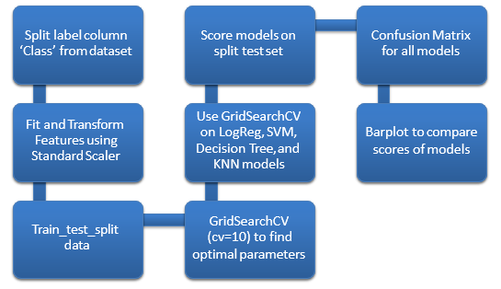
Predictive Analysis (Classification)
GitHub URL :
https://github.com/evanserlangga/IBMDSPFP/blob/289c3bb6d51329c83454dfe144674c1d9fba7a1b/SpaceX_Machine_Learning_Prediction_Part_5_jupyterlite.ipynb

Slide 16
Results
In the upcoming slides, I will provide a comprehensive overview of the work completed during this project. First, I will delve into the results of our exploratory data analysis (EDA), which involved a thorough examination of key variables such as Flight Number, Payload Mass, Launch Site, Orbit, Class, and Year. This analysis helped to identify patterns and relationships within the data that are crucial for developing accurate predictive models.
Next, I will present an interactive analytics demo through a series of detailed screenshots. This demo will illustrate how advanced visualization tools, including Folium maps and Plotly Dash, were utilized to create dynamic and insightful visual representations of the data. These visualizations enabled a deeper understanding of the spatial distribution of launch sites, the success rates of landings, and other significant factors influencing mission outcomes.
Finally, I will share the results of our predictive analysis. This section will cover the development and evaluation of several machine learning models designed to predict the success of Stage 1 rocket landings. I will discuss the model selection process, the tuning of hyperparameters using GridSearchCV, and the performance metrics that indicate the accuracy and reliability of the models. This comprehensive presentation aims to demonstrate the effectiveness of the analytical methods and tools employed in this project, ultimately contributing to Space Y's goal of achieving successful rocket recoveries.

Slide 17

Section 2

Slide 18
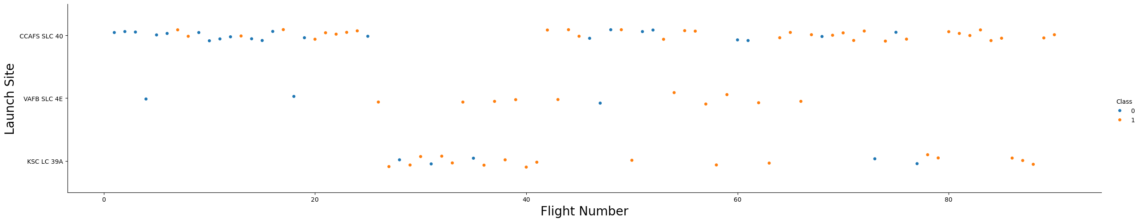
Flight Number vs. Launch Site
The graphic indicates a clear increase in the success rate of landings over time, as reflected in the Flight Number. Notably, there appears to be a significant breakthrough around the 20th flight, which substantially boosted the success rate. Additionally, Cape Canaveral Air Force Station (CCAFS) stands out as the primary launch site, handling the highest volume of launches.

Slide 19
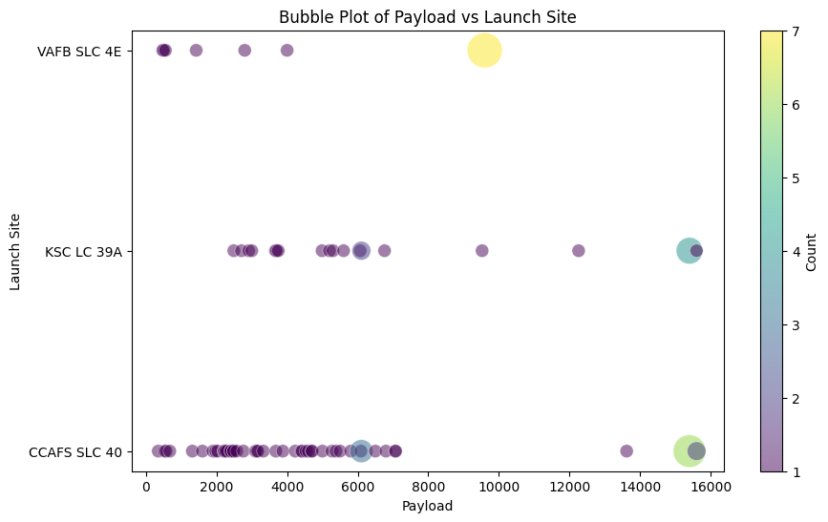
Payload vs. Launch Site
The data shows that payload masses predominantly range between 0 and 6000 kg. Furthermore, it appears that different launch sites tend to handle varying payload masses, indicating a potential specialization or preference for certain payload ranges at specific locations.

Slide 20
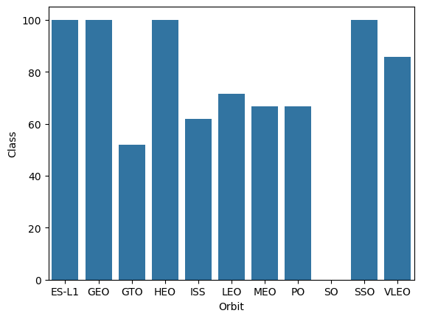
Success Rate vs. Orbit Type
The data analysis reveals the following success rates for different orbits, with sample sizes indicated in parentheses:
- ES-L1 (1), GEO (1), and HEO (1) each have a 100% success rate.
- SSO (5) also maintains a 100% success rate.
- VLEO (14) shows a decent success rate with a significant number of attempts.
- SO (1) has a 0% success rate.
- GTO (27) has approximately a 50% success rate but has the largest sample size.
Success Rate Scale with 0 as 0% ;
0.6 as 60% ; 1 as 100%

Slide 21
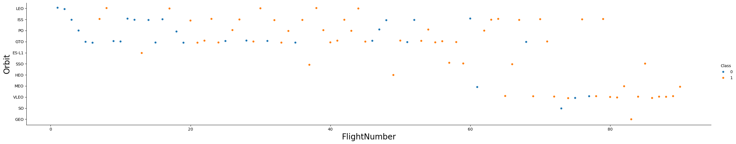
Flight Number vs. Orbit Type
Over the course of Flight Number, there is observable variability in SpaceX's launch orbit preferences, which correlates closely with launch outcomes. Initially focusing on LEO orbits, which saw moderate success, SpaceX later shifted towards VLEO orbits in recent launches. The data suggests that SpaceX tends to perform better in lower orbits or Sun-synchronous orbits, highlighting a strategic preference that aligns with higher success rates in these specific orbital configurations.

Slide 22
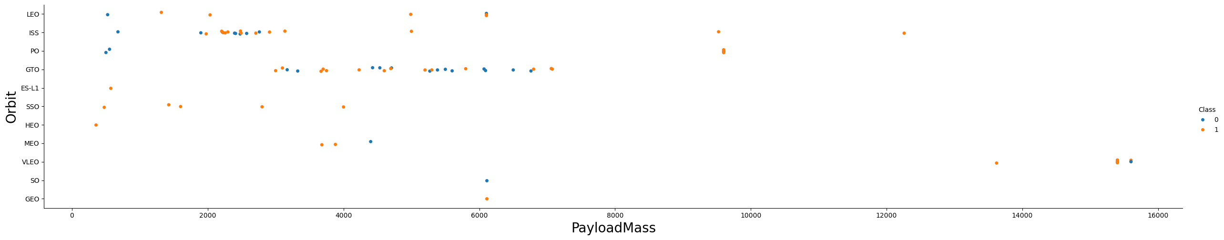
Payload vs. Orbit Type
There appears to be a correlation between payload mass and orbit type based on the analysis. Orbits such as LEO and SSO tend to accommodate payloads with relatively lower mass. In contrast, VLEO, which shows high success rates, typically handles payloads at the higher end of the mass spectrum. This observation underscores how payload characteristics, including mass, are tailored to suit specific orbital requirements and operational success in SpaceX's missions.

Slide 23
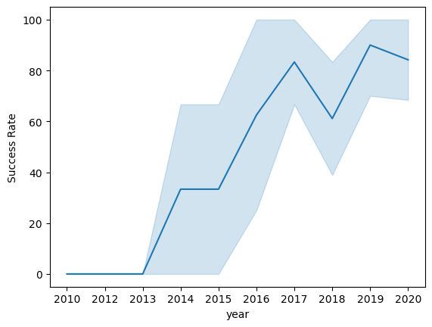
Launch Success Yearly Trend
The analysis indicates a general trend of increasing success rates over time since 2013, with a notable slight dip observed in 2018. In recent years, success rates have stabilized around 80%, reflecting a consistent improvement in SpaceX's operational reliability and mission outcomes.
95% confidence interval (light blue shading)

Slide 24
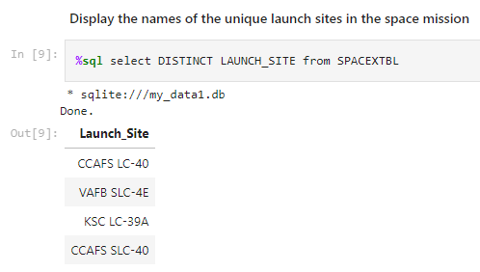
All Launch Site Names
Based on the query and the information provided, it appears that there are three unique launch site names in the database:
1. CCAFS SLC-40 (Cape Canaveral Air Force Station Space Launch Complex 40)
2. KSC LC-39A (Kennedy Space Center Launch Complex 39A)
3. VAFB SLC-4E (Vandenberg Air Force Base Space Launch Complex 4E)
The variations like CCAFS SLC-40 and CCAFS LC-40 likely refer to the same launch site but with data entry errors or variations in naming conventions.

Slide 25
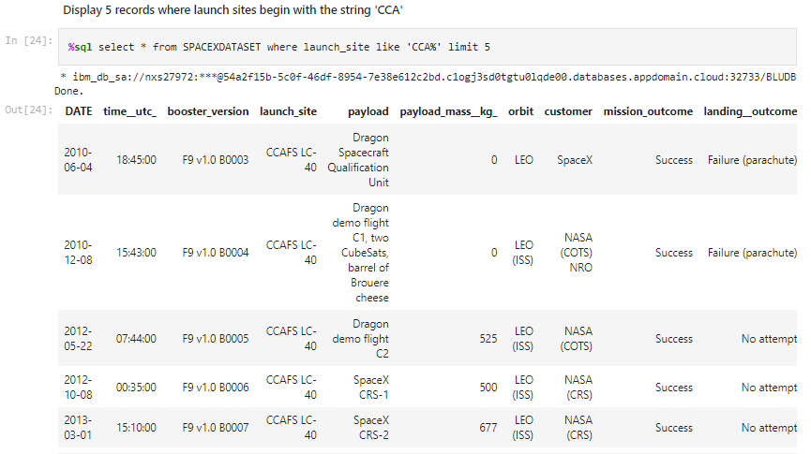
Launch Site Names Begin with 'CCA'
Showing the first five entries in database with Launch Site name beginning with CCA.

Slide 26
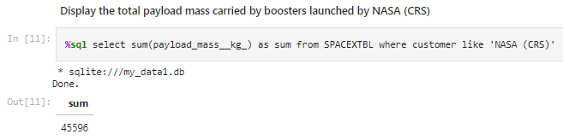
Total Payload Mass
This query calculates the total payload mass in kilograms for missions where NASA was the customer. The use of CRS (Commercial Resupply Services) indicates that these payloads were specifically intended for delivery to the International Space Station (ISS).

Slide 27
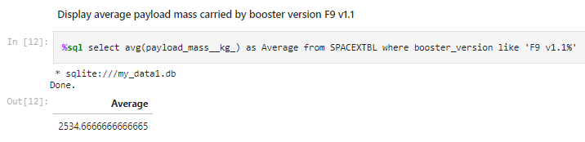
Average Payload Mass by F9 v1.1
This query computes the average payload mass for launches utilizing the booster version F9 v1.1. The average payload mass associated with F9 1.1 tends to fall on the lower end of our payload mass range.

Slide 28
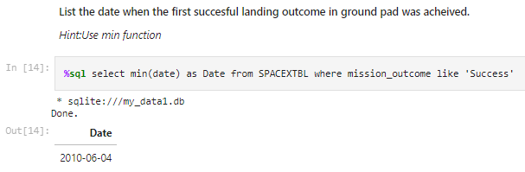
First Successful Ground Landing Date
This query returns the first successful ground pad landing date.

Slide 29
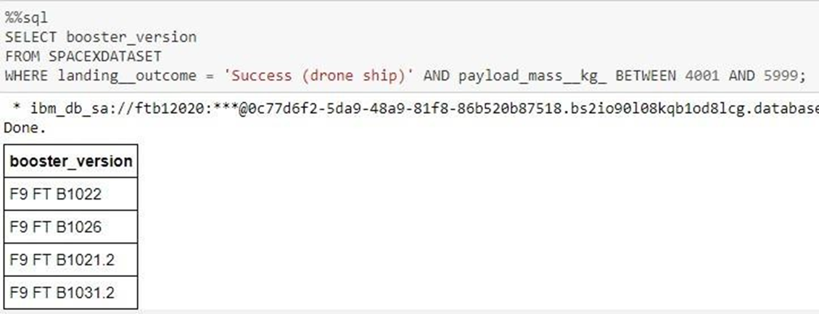
Successful Drone Ship Landing with Payload between 4000 and 6000
This query retrieves the four booster versions that achieved successful drone ship landings with a payload mass ranging between 4000 and 6000 kilograms (non-inclusive).

Slide 30
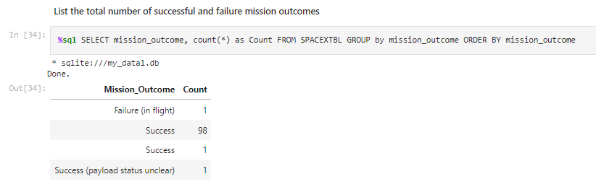
Total Number of Successful and Failure Mission Outcomes
This query provides a count of each mission outcome. SpaceX achieves its mission outcome nearly 99% of the time, indicating that most landing failures are deliberate or intended. Interestingly, there is one launch with an unclear payload status, and unfortunately, one mission resulted in a mid-flight failure.

Slide 31
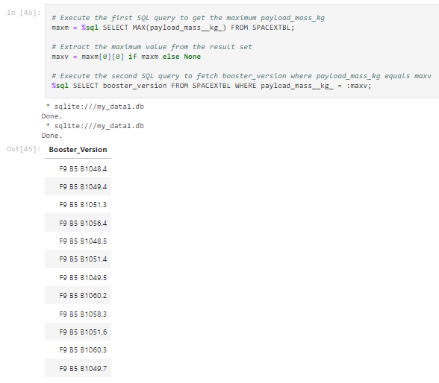
Boosters Carried Maximum Payload
This query identifies the booster versions that carried the highest payload masses. These booster versions, all falling under the F9 B5 B10xx.x category, are remarkably similar. This suggests a correlation between the booster version used and the payload mass capacity it can accommodate.

Slide 32
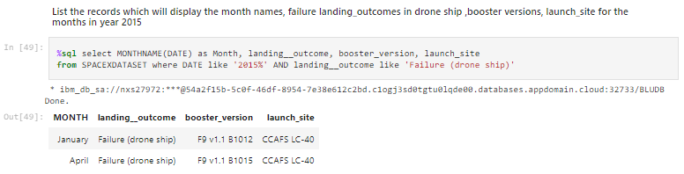
2015 Launch Records
This query retrieves the month, landing outcome, booster version, payload mass (in kilograms), and launch site for launches in 2015 where the Stage 1 failed to land on a drone ship. There were two such occurrences during this period.

Slide 33
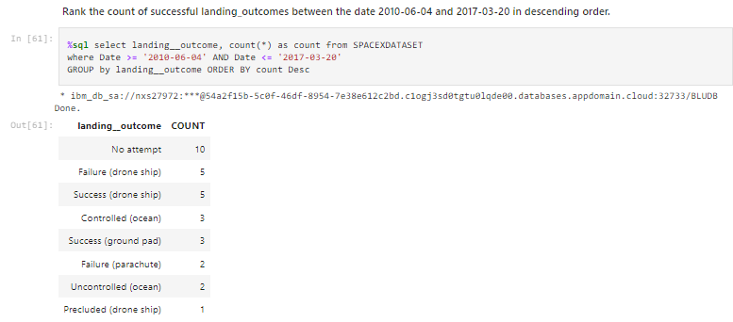
Rank Landing Outcomes Between 2010-06-04 and 2017-03-20
This query provides a list of successful landings between June 4, 2010, and March 20, 2017, inclusive. Successful landings during this period are categorized into two types: drone ship and ground pad landings. In total, there were 8 successful landings documented.

Slide 34

Section 3

Slide 35

Launch Sites Geography
The map on the left illustrates the geographical locations of all launch sites across the United States. Meanwhile, the map on the right focuses specifically on the two launch sites in Florida, highlighting their proximity to each other. Notably, all launch sites are situated in close proximity to the ocean.

Slide 36

Colored-Launch Site Markers
On the Folium map, clusters can be clicked to view individual markers representing successful landings (green icon) and failed landings (red icon). For instance, in the case of VAFB SLC-4E, clicking on the cluster reveals a breakdown of 4 successful landings and 6 failed landings. This interactive feature provides detailed insights into the distribution and outcomes of launches at specific launch sites.

Slide 37
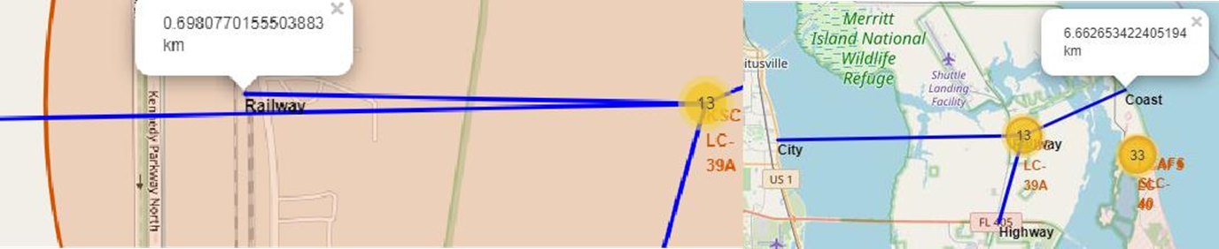
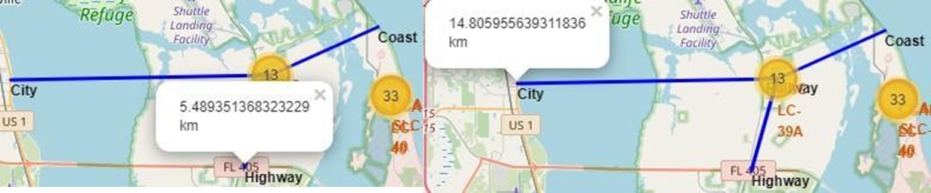
Key Locations Lines
Taking KSC LC-39A as an example, launch sites are positioned in close proximity to railways, facilitating the transportation of large equipment and supplies essential for missions. They are also strategically located near highways, ensuring easy access for personnel and efficient supply transport. Additionally, these sites are situated near coastlines, which provides a safe area for rocket debris in case of launch failures, thereby minimizing risks to densely populated urban areas.

Slide 38

Section 4

Slide 39


Successful Launches Pie Chart
This represents the distribution of successful landings across all launch sites. CCAFS LC-40, which is the former name of CCAFS SLC-40, and KSC have an equal number of successful landings. However, a majority of these successful landings occurred before the name change. VAFB, on the other hand, has the smallest share of successful landings, possibly due to a smaller sample size and the increased challenges associated with launching from the west coast.

Slide 40

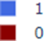
Launch Site with the Highest Succession Rate
KSC LC-39A has the highest success rate with 10 successful landings and 3 failed landings.
Blue = Success
Red = Failure

Slide 41

Payload Mass x Success
In the Plotly dashboard, there is a payload range selector that ranges from 0 to 10,000, which is below the maximum payload of 15,600 kg. The 'Class' attribute indicates 1 for successful landings and 0 for failures. The scatter plot also incorporates booster version categories by color and represents the number of launches with point size. Interestingly, within the specific payload range of 0 to 6,000 kg, there are two instances of failed landings despite payloads being recorded as zero kilograms.

Slide 42

Section 5

Slide 43
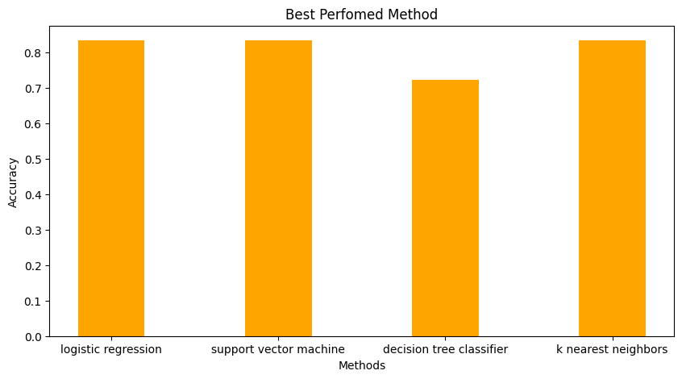
Classification Accuracy
All models achieved a similar accuracy of 83.33% on the test set. However, the test set is quite small, with only 18 samples. This small sample size can result in significant variability in accuracy outcomes, as seen with the Decision Tree Classifier model in repeated tests. To accurately identify the best model, we likely need a larger dataset.

Slide 44
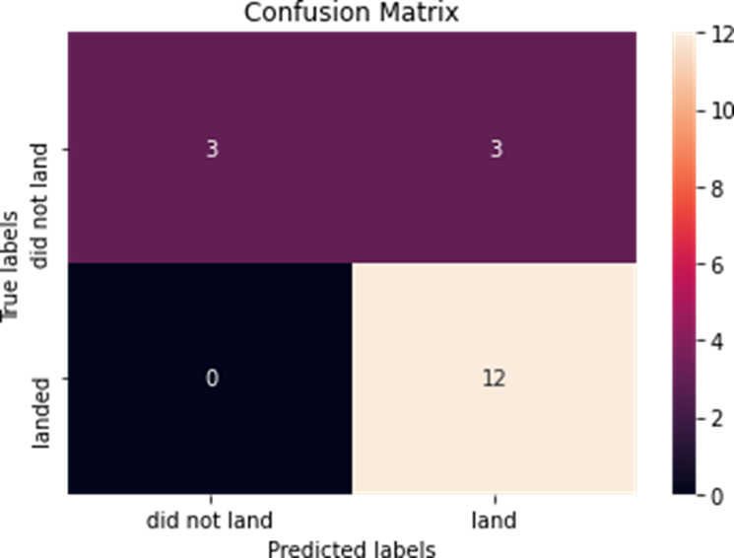
Confusion Matrix
Because all models showed identical performance on the test set, their confusion matrices are also identical. The models correctly predicted 12 successful landings and 3 unsuccessful landings. However, they incorrectly predicted 3 successful landings when the actual result was an unsuccessful landing (false positives). This suggests that our models have a tendency to overpredict successful landings.
Correct predictions are on a diagonal from top left to bottom right.

Slide 45
Conclusions
Our task was to develop a machine learning model for SpaceY, aiming to compete with SpaceX. The objective was to predict the successful landing of Stage 1 to save approximately $100 million USD.
We utilized data from a public SpaceX API and web-scraped the SpaceX Wikipedia page. We labeled the data and stored it in a DB2 SQL database, then created a dashboard for visualization.
The machine learning model we developed achieved an accuracy of 83%. Allon Mask of SpaceY can use this model to predict, with relatively high accuracy, whether a launch will have a successful Stage 1 landing before it takes place, aiding in the decision to proceed with the launch.
Collecting more data could help in identifying the best machine learning model and further improving accuracy.

Slide 46

Appendix
GitHub Repository URL :
https://github.com/evanserlangga/IBMDSPFP
References :
https://en.wikipedia.org/wiki/SpaceX

Slide 47


